Slide 1
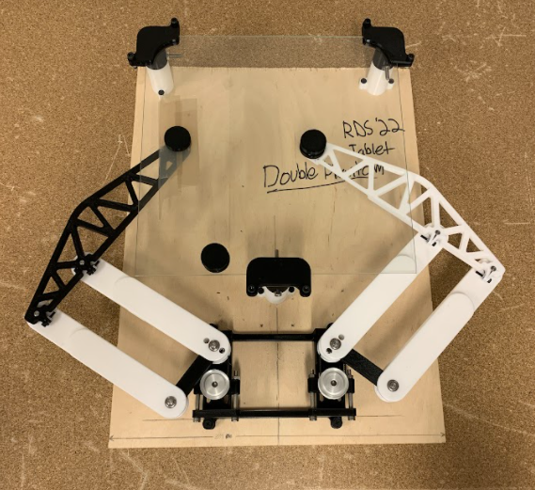
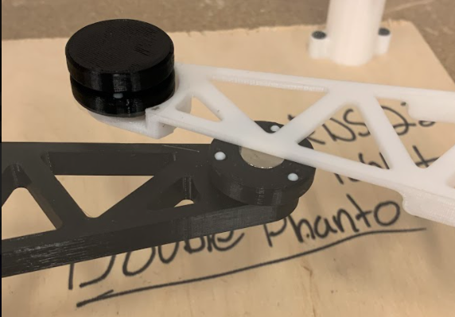
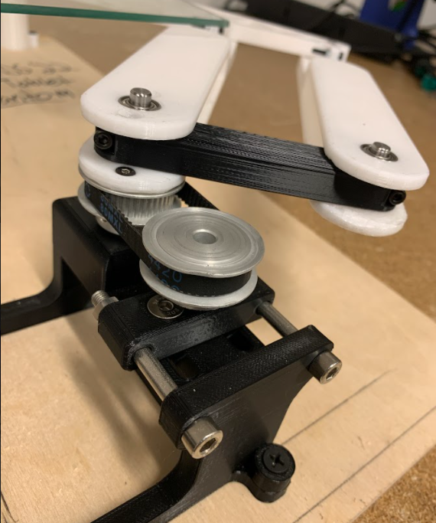
HAPTIC DEVICE

Slide 2
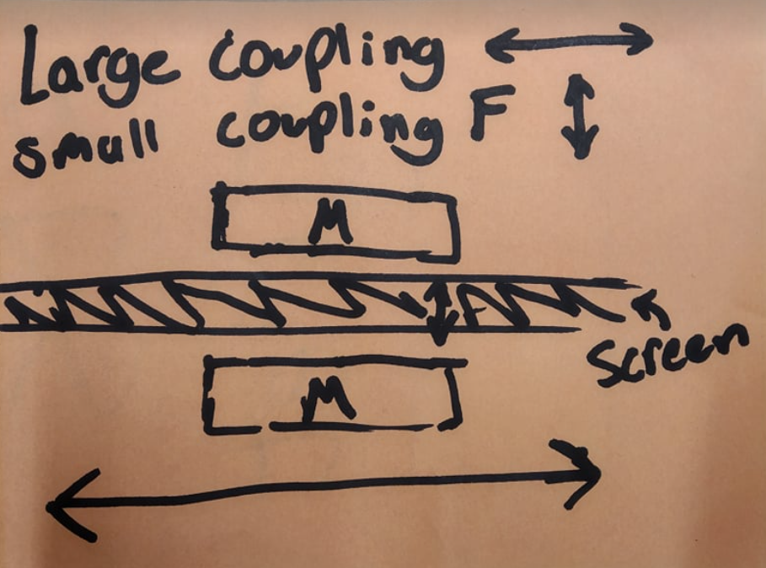
KEY REQUIREMENTS
LOW FRICTION:
In free motion, the user should experience no more than 0.22 lbs or 100 g of inertia.
In free motion, the gantry device should be able to match finger speeds up to 150 mm/s or 5.9 in/s.
SHEAR STRENGTH:
When the user is interacting with a virtual wall, the device will be able to respond with a stiffness of 1 N/mm or 5.71 lbs/in

Slide 3
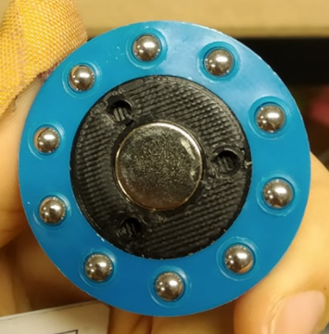
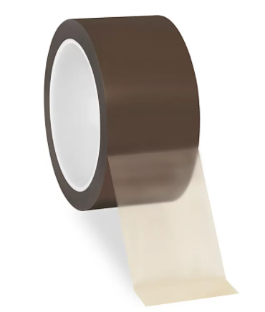
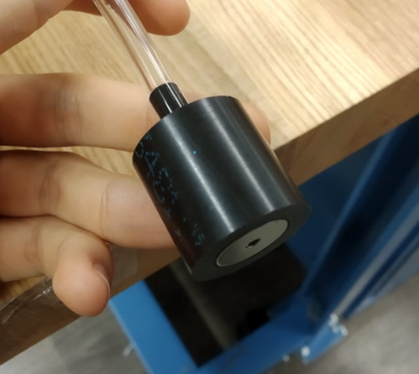
CURRENT MAGNET DESIGN
Teflon tape / balls
Grease
Roller Bearings
Air bearing

Slide 4
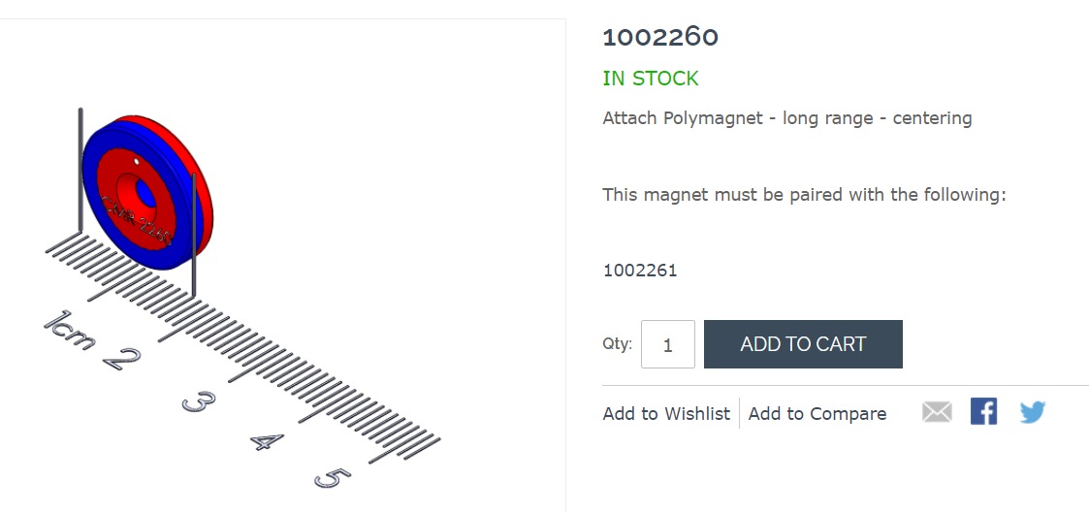
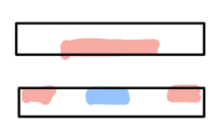
Polymagnet design

